Slide 1
Network and Computer Security
2021-2022
Prof. dr. ir. Eli De Poorter
Vakgroep Informatietechnologie – IDLab
© Eli De Poorter

Slide 2
Cursusbeschrijving
Cursus
  Slides + notepages
  English slides
    but Dutch course and examination
Ufora
  Slides under /theory
  Additional materials and links

Slide 3
Practical arrangements
Class hours: theory
  Physical classes
    If COVID conditions do not change…
  Theory class:
    Monday 10u30 - 12u30
    Building B, room B2.018 (second floor)

Slide 4
Practical arrangements
Class hours: lab sessions
  Subject to change (depending on COVID-19 safety measurements)
    Always check Ufora!
  Currently: physical
    Thursday 14u30 - 17u30
    Building B, room 2.031/2.033 en 2.035
    Sessions
      Labo’s: encryption protocols, SSH, VPN, Certificates, IPTables
      Project: web security (online, free to plan when best suited)

Slide 5
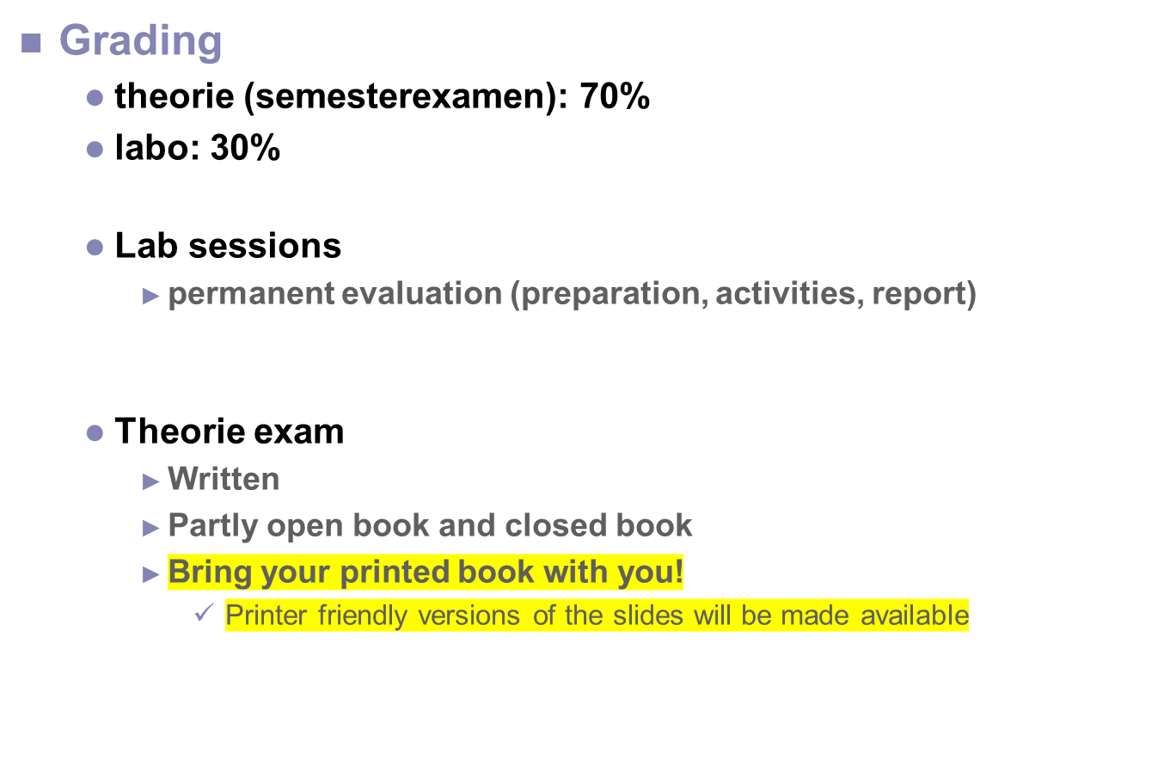
Grading

Slide 6
Contacts
Teacher
  Prof. dr. ir. Eli De Poorter
  E-mail: eli.depoorter@ugent.be
  Ghent University – imec - IDLab
  iGent tower, floor 11, room 210.016
  Technologiepark-Zwijnaarde 126
  9052 Gent
  http://www.ibcn.intec.ugent.be/route.html
Lab organisation
  Wim Van Den Breen, Wim.VanDenBreen@UGent.be

Slide 7
Literature
William Stallings, “Cryptography and Network Security, principles and practices”, 7th (international) edition, Prentice Hall, 2017
  Good reference work
  Website: http://williamstallings.com/Cryptography/
    Useful for errata and additional resources
  Older editions can still be used
  Not mandatory
Alfred J. Menezes, Paul C. van Oorschot, and Scott A. Vanstone , “Handbook of Applied Cryptography”, CRC Press, 2001, ISBN 0-8493-8523-7
  Rather mathematical approach of cryptography (and somewhat older)
  Freely available in pdf format at
  http://cacr.uwaterloo.ca/hac/
Matt Bishop, “Computer Security: Art and Science”, Addison Wesley, Pearson Education, 2003, ISBN-13: 978-0-201-44099-7
  A true reference about security (1136 p.)
  Also deals with aspects of security policy

Slide 8
More information?
Websites
  https://crypto.stackexchange.com/
    For all your questions regarding encryption protocols
    Often inspiration for many exam questions
  Outstanding security blogs discussing a very broad range of security related topics
    https://krebsonsecurity.com/
    https://www.schneier.com/
  http://www.darkreading.com/
    Security news website

Slide 9
Want to experiment?
Software
  Legal alternative to practice your hacking skills
    https://www.hackthissite.org/
  PGP
    http://www.gnupg.org
      The GPL version
    http://www.openpgp.org/
  OpenSSL
    http://www.openssl.org
    TLS & SSL + generic toolsets
  CrypTool
    http://www.cryptool.org/en/
    Educative cryptography software

